Slide 1

2018-2019 Athletics

Slide 2
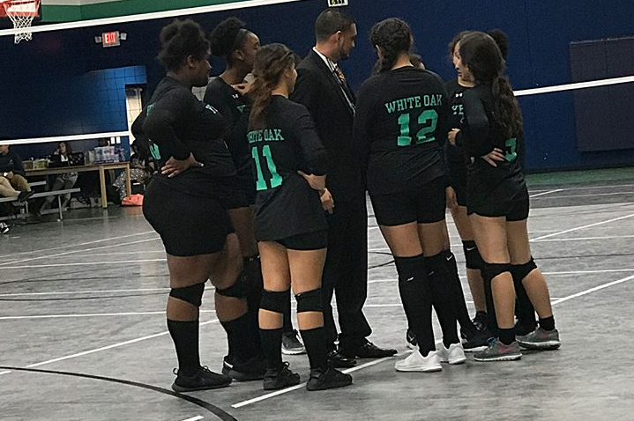

GOALS
2017-2018
2018-2019
0% All teams participate in one community service project
87% Eligibility
55% Athletes will have a 75 and above in ALL classes (RC)
100% All teams participate in one community service project
89% Eligibility
75% Athletes will have a 75 and above in ALL classes (RC)

Slide 3
2018-2019 COACHING STAFF
Name | Position | Sport(s) Coached | Contact Information
Joshua Gutierrez | Athletic Director | Varsity Girls Volleyball Varsity Boys Basketball | Email: Joshua.Gutierrez@yesprep.org Cell: 281-814-9047
Name | Position | Sport(s) Coached | Contact Information
Parker Pass | HS AP Spanish | Varsity Boys Soccer MS Boys Soccer | Parker.pass@yesprep.org
Danielle Washington | Director of College Counseling | Varsity Cross Country MS Girls Basketball Varsity Track & Field | Danielle.Washington@yesprep.org
Justin Johnson | 7th GLC and Math | MS Cross Country MS Track & Field | Justin.Johnson@yesprep.org
Kristen Hardaway | 11th ELA | MS Girls Volleyball Varsity Girls Basketball | Kristen.Hardaway@yesprep.org
Jessica Oswald | 11th GLC US History | MS Girls Soccer Varsity Girls Soccer | Jessica.Oswald@yesprep.org
Jaime Morgan | 6th Math | MS Boys Basketball | Jaime.morgan@yesprep.org

Slide 4
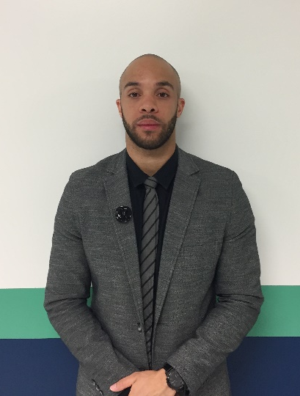
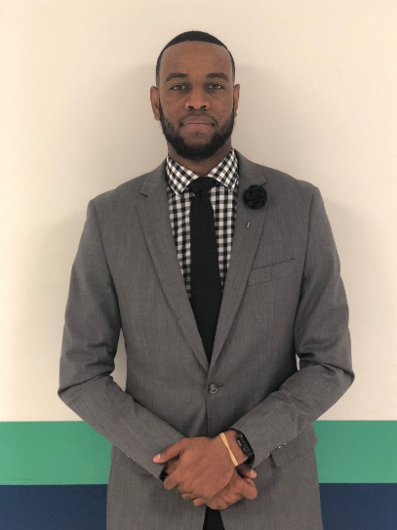
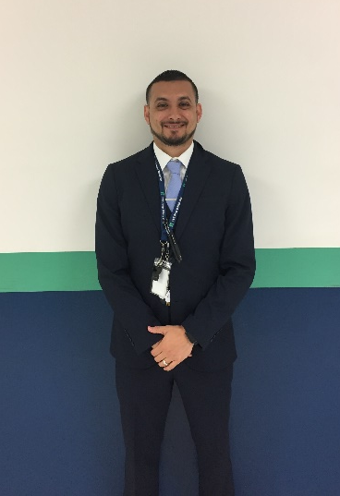
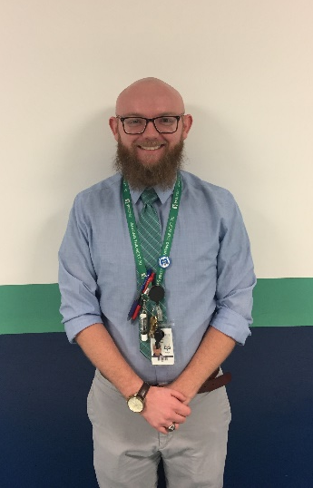
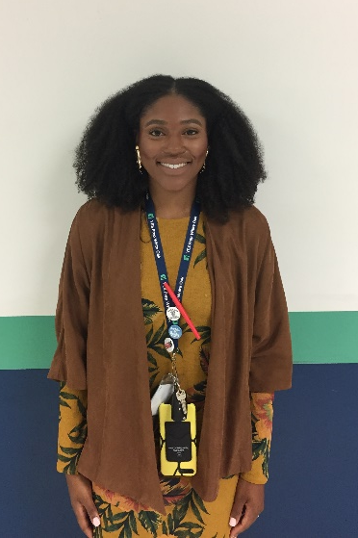
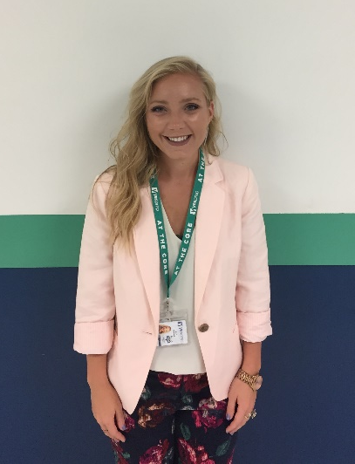
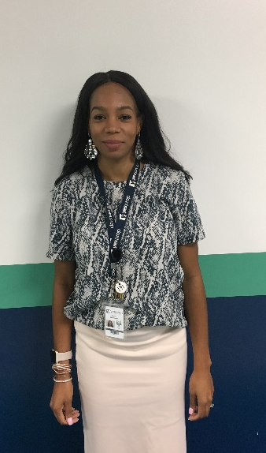
2018-2019 COACHING STAFF

Slide 5

PRACTICE/GAME DAYS
Practice Days:
Monday, Tuesday, Thursday, Friday (Depending on season)
Gym or the Parking Lot/Field
4:00-5:30 PM
5:30-7:00 PM
Game Days:
Tuesdays, Thursday, Friday, Saturday
Gym or the Field
3:00-7:30 PM
8:00 AM-12:00 PM

Slide 6
PLAYING TIME EXPECTATIONS
EARNED
Know your Role on the TEAM
TEAM player
Hard Work
Coachable
Great Sportsmanship
“There are no elevators to success, you must take the stairs”

Slide 7

PRACTICE ATTIRE

Slide 8
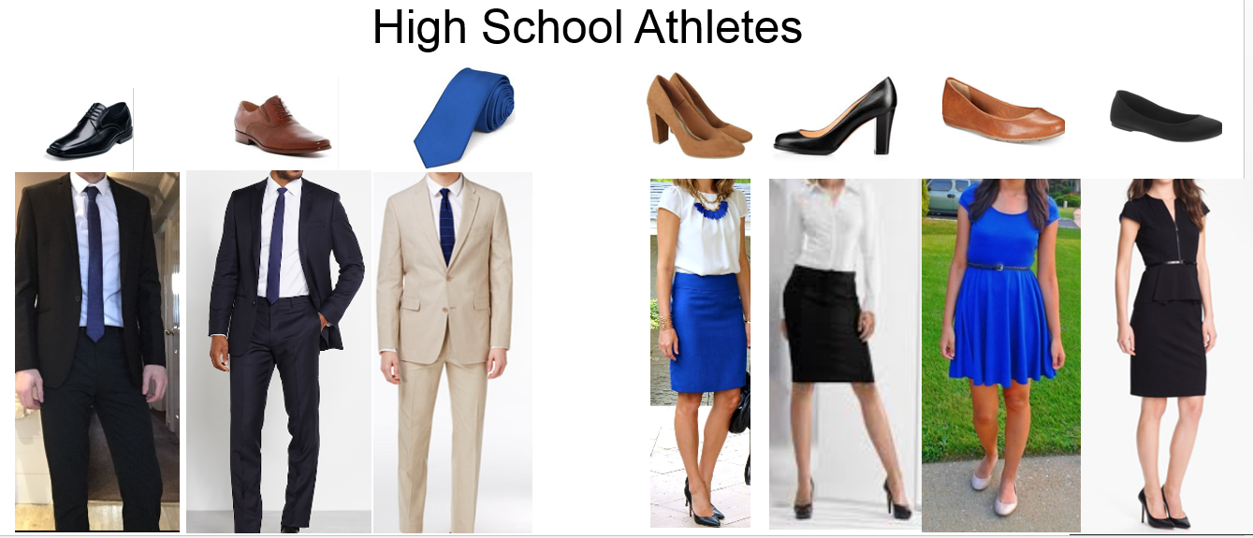
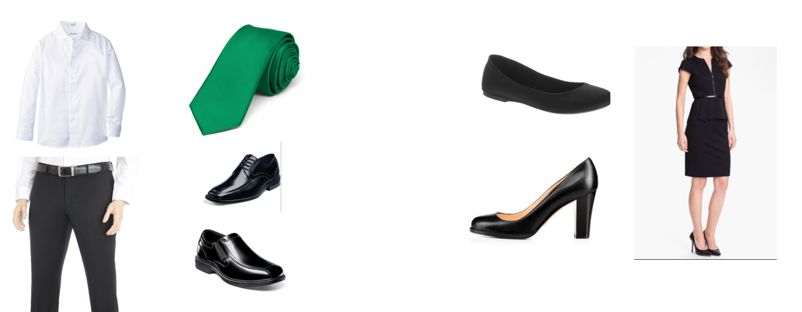
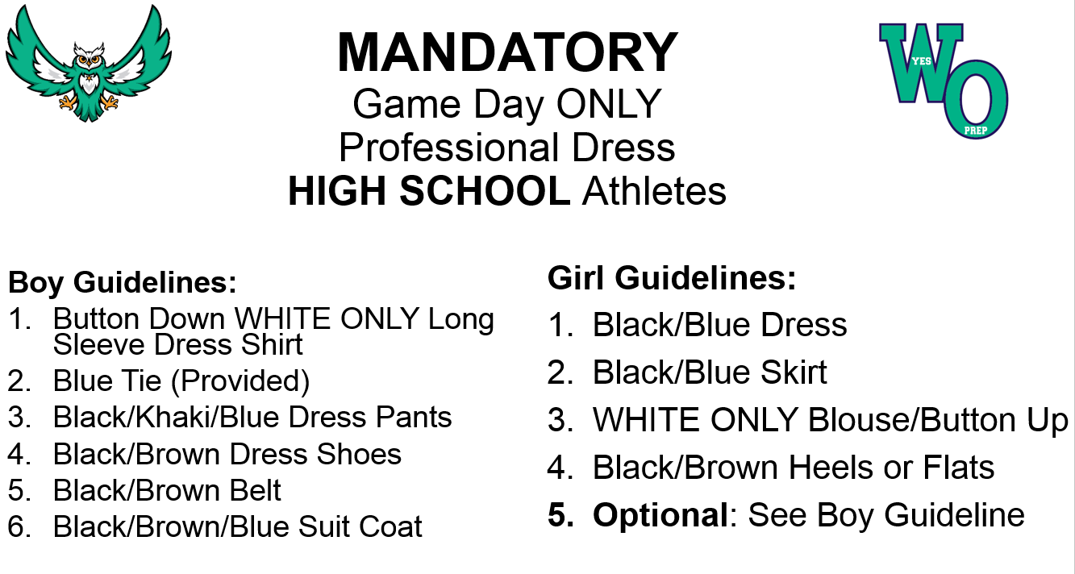
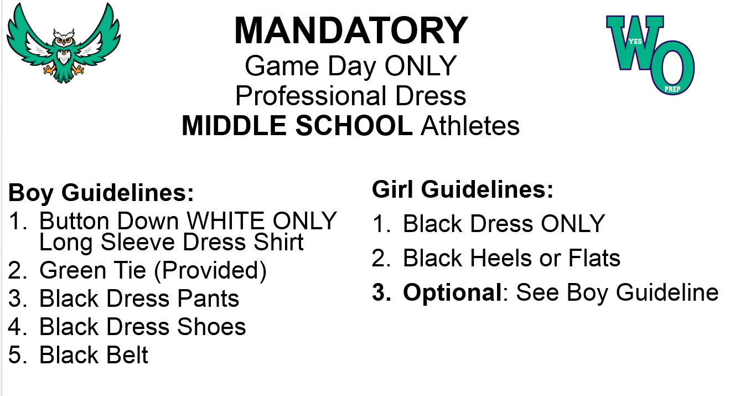
GAME DAY ATTIRE

Slide 9
ATHLETIC FEE
1st Sport-$75 ($25, $25, $25 EOD Friday)
2nd Sport-$50 ($20, $20, $10 EOD Friday)
3rd Sport-$25 ($10, $10, $5 EOD Friday)
Facility, Program and Transportation, Practice Gear
Timeline: 3 weeks
*Pay in full or weekly, student-athlete will not be able to participate in practice or games if fee is not paid in full or by the end of day on Friday

Slide 10


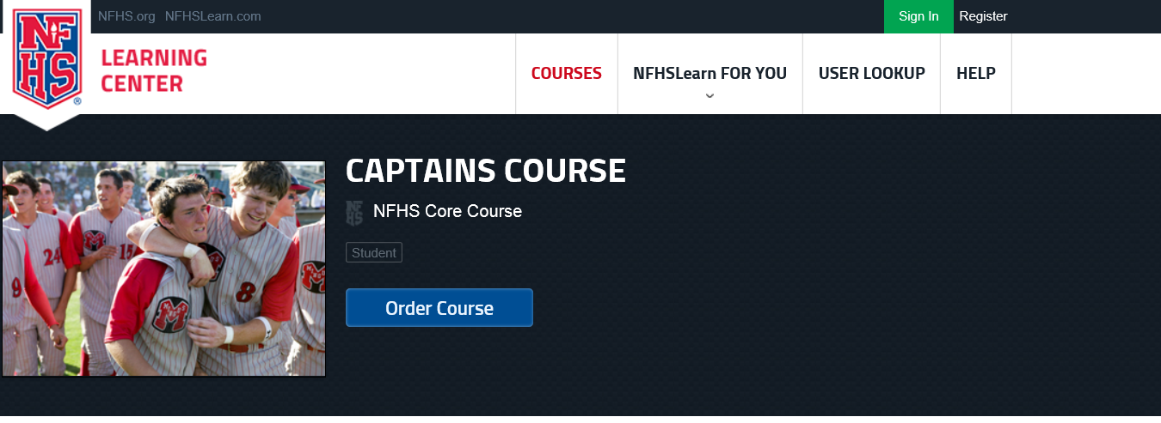
MANDATORY Captain’s Course ALL 1st Time High School Athletes
Website: https://www.nfhslearn.com/
INSTRUCTIONS:
Complete on computer or phone
Register FIRST
Click Courses
Select Captain's Course
Click Order Course
Complete and Submit to Coach Gutierrez ASAP! joshua.gutierrez@yesprep.org
DUE: Prior to First Game/Meet
Will NOT be allowed to participate in athletic season without certificate!

Slide 11
Handbook

Slide 12

RESOURCES
Athletic Website
Instagram Page @whiteoak_athletics1
Athletic Bulletin Board Outside of Gym
Joshua Gutierrez 281-814-9047

Slide 13
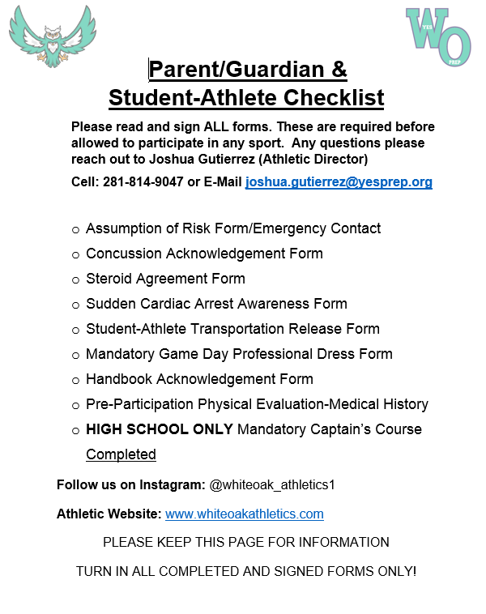
SIGNED/COMPLETED PAPERWORK

